Slide 1
Causes of death case study
Vaishnavi Kalambhe

Slide 2
About dataset
Content
In this Dataset, we have Historical Data of different cause of deaths for all ages around the World. The key features of this Dataset are: Meningitis, Alzheimer's Disease and Other Dementias, Parkinson's Disease, Nutritional Deficiencies, Malaria, Drowning, Interpersonal Violence, Maternal Disorders, HIV/AIDS, Drug Use Disorders, Tuberculosis, Cardiovascular Diseases, Lower Respiratory Infections, Neonatal Disorders, Alcohol Use Disorders, Self-harm, Exposure to Forces of Nature, Diarrheal Diseases, Environmental Heat and Cold Exposure, Neoplasms, Conflict and Terrorism, Diabetes Mellitus, Chronic Kidney Disease, Poisonings, Protein-Energy Malnutrition, Road Injuries, Chronic Respiratory Diseases, Cirrhosis and Other Chronic Liver Diseases, Digestive Diseases, Fire, Heat, and Hot Substances, Acute Hepatitis.

Slide 3
Data Glossary
01. Country/Territory - Name of the Country/Territory
02. Code - Country/Territory Code
03. Year - Year of the Incident
04. Meningitis - No. of People died from Meningitis
05. Alzheimer's Disease and Other Dementias - No. of People died from Alzheimer's Disease and Other Dementias
06. Parkinson's Disease - No. of People died from Parkinson's Disease
07. Nutritional Deficiencies - No. of People died from Nutritional Deficiencies
08. Malaria - No. of People died from Malaria
09. Drowning - No. of People died from Drowning
10. Interpersonal Violence - No. of People died from Interpersonal Violence
11. Maternal Disorders - No. of People died from Maternal Disorders
12. Drug Use Disorders - No. of People died from Drug Use Disorders
13. Tuberculosis - No. of People died from Tuberculosis
14. Cardiovascular Diseases - No. of People died from Cardiovascular Diseases
15. Lower Respiratory Infections - No. of People died from Lower Respiratory Infections

Slide 4
16. Neonatal Disorders - No. of People died from Neonatal Disorders
17. Alcohol Use Disorders - No. of People died from Alcohol Use Disorders
18. Self-harm - No. of People died from Self-harm
19. Exposure to Forces of Nature - No. of People died from Exposure to Forces of Nature
20. Diarrheal Diseases - No. of People died from Diarrheal Diseases
21. Environmental Heat and Cold Exposure - No. of People died from Environmental Heat and Cold Exposure
22. Neoplasms - No. of People died from Neoplasms
23. Conflict and Terrorism - No. of People died from Conflict and Terrorism
24. Diabetes Mellitus - No. of People died from Diabetes Mellitus
25. Chronic Kidney Disease - No. of People died from Chronic Kidney Disease
26. Poisonings - No. of People died from Poisoning
27. Protein-Energy Malnutrition - No. of People died from Protein-Energy Malnutrition
28. Chronic Respiratory Diseases - No. of People died from Chronic Respiratory Diseases
29. Cirrhosis and Other Chronic Liver Diseases - No. of People died from Cirrhosis and Other Chronic Liver Diseases
30. Digestive Diseases - No. of People died from Digestive Diseases
31. Fire, Heat, and Hot Substances - No. of People died from Fire or Heat or any Hot Substances
32. Acute Hepatitis - No. of People died from Acute Hepatitis

Slide 5
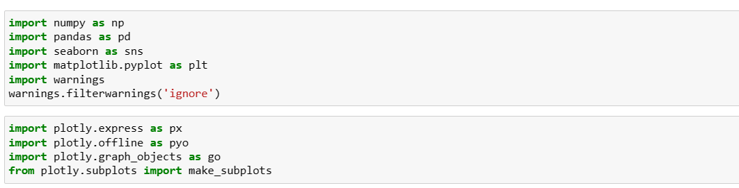
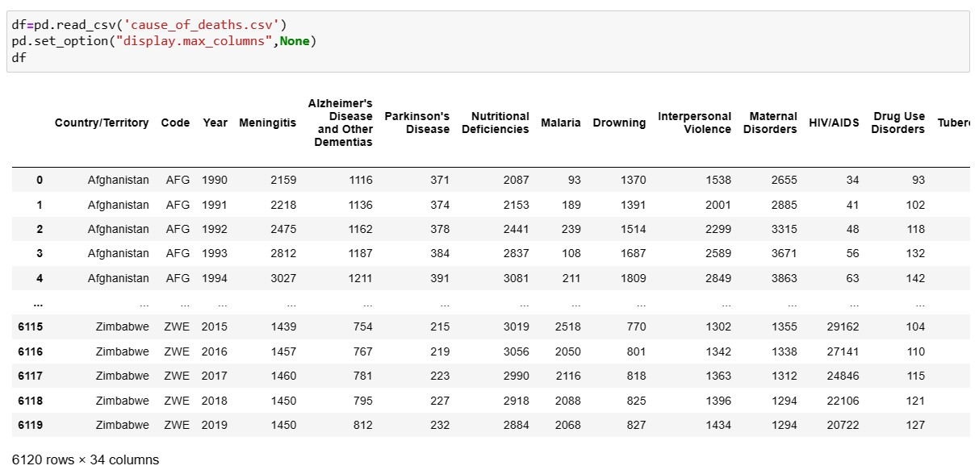
Importing libraries and the dataset

Slide 6
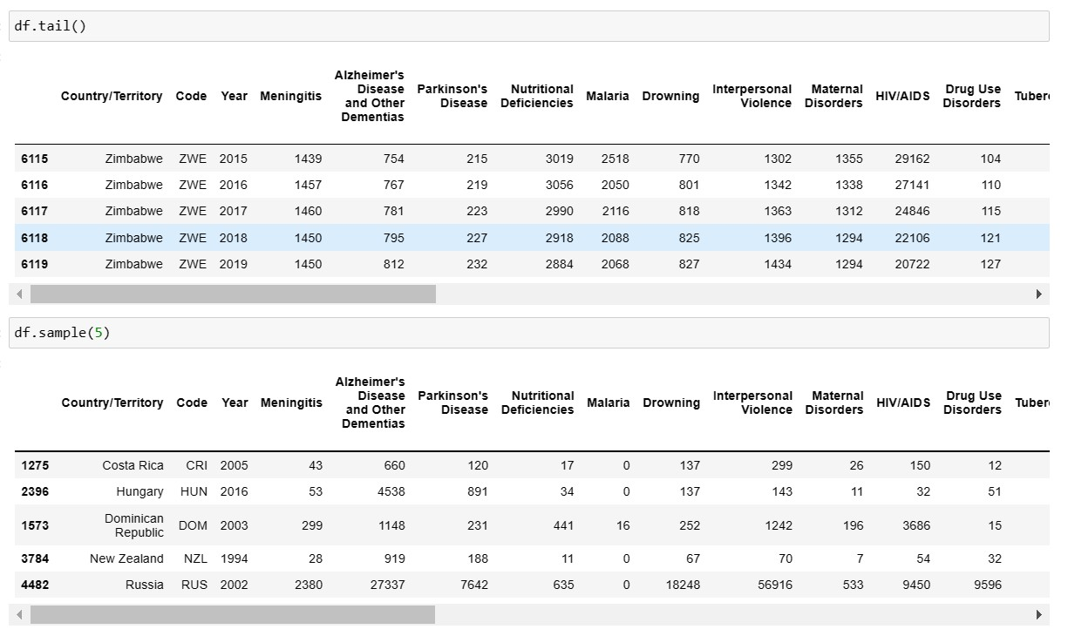
Checking the data types

Slide 7
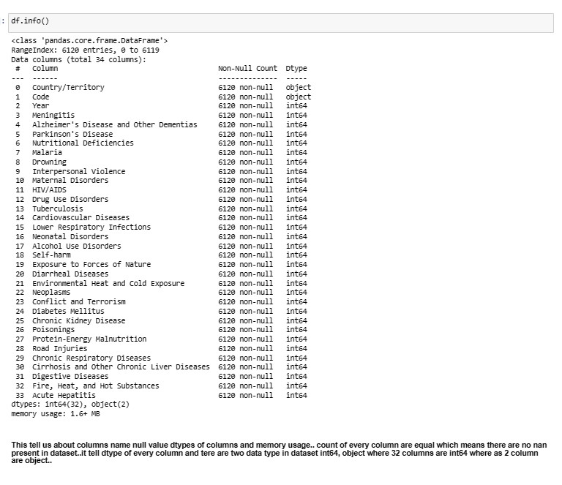
Info about the dataset

Slide 8
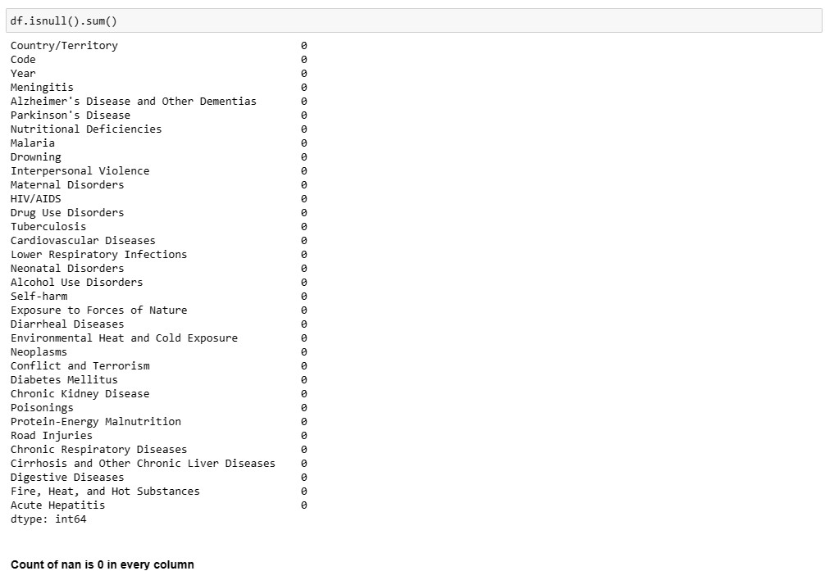
Check the null values

Slide 9
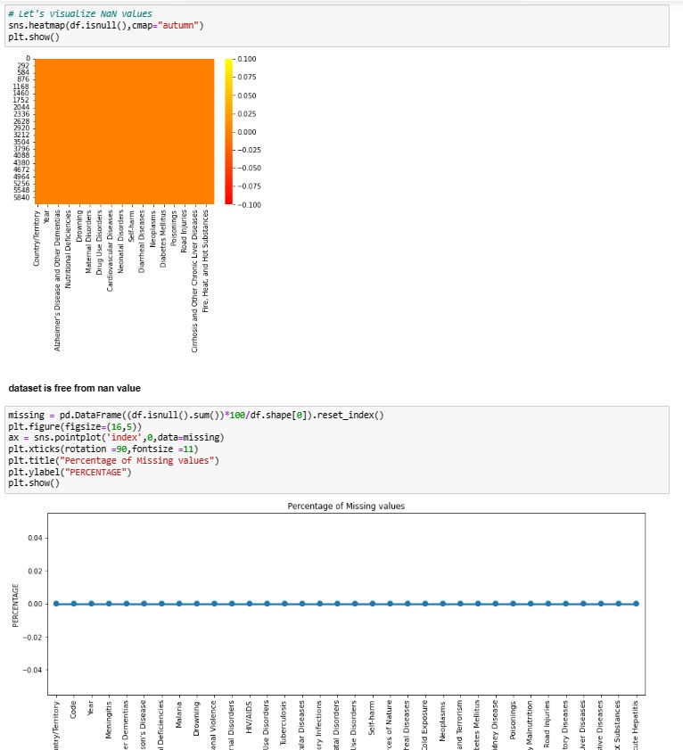
heatmap

Slide 10
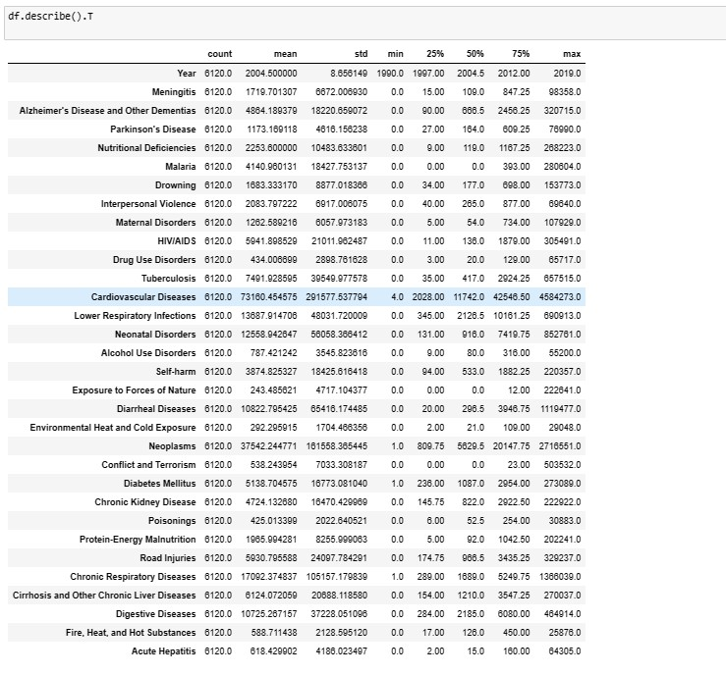
Describing the dataset
Here we have described the whole dataset by DESCRIBE command .
We can see the count of all the columns that is 6120 which means no Null value is present in the dataset.
We can see the mean and standard deviation of all the Numeric columns in the dataset.
We can see the Min and Max from all the columns.
We can see Quartiles over here too

Slide 11
Dividing data
Diving the cause of deaths in 4 different categories :-
Death by Diseases
Death by environment and accident.
Death by crime, terror , self harm
Death by Chronic Diseases

Slide 12
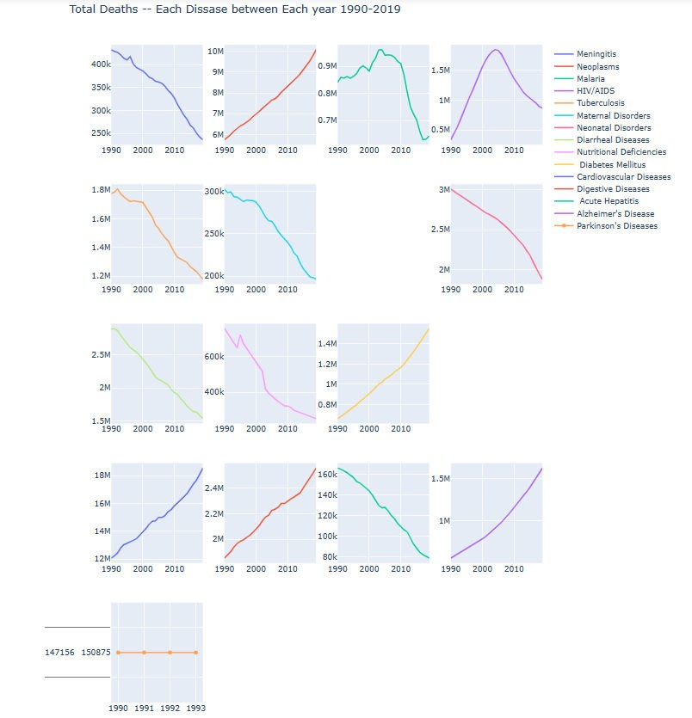
Data visualization
This is Plot shows how much Death has taken places by Diseases In all the year since 1990- 2019.

Slide 13
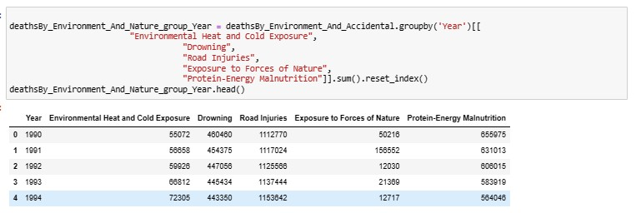
Death by environment and accident

Slide 14
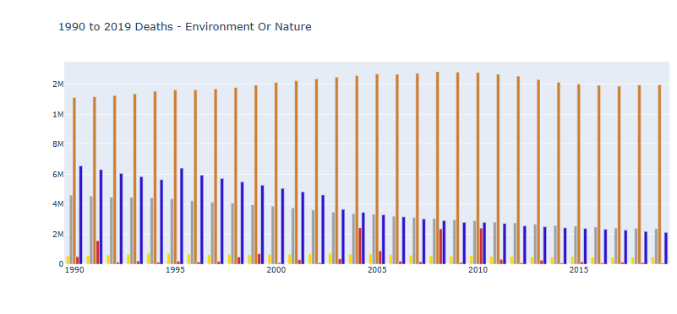
In this plot deaths caused by Environment and accidents are shown

Slide 15
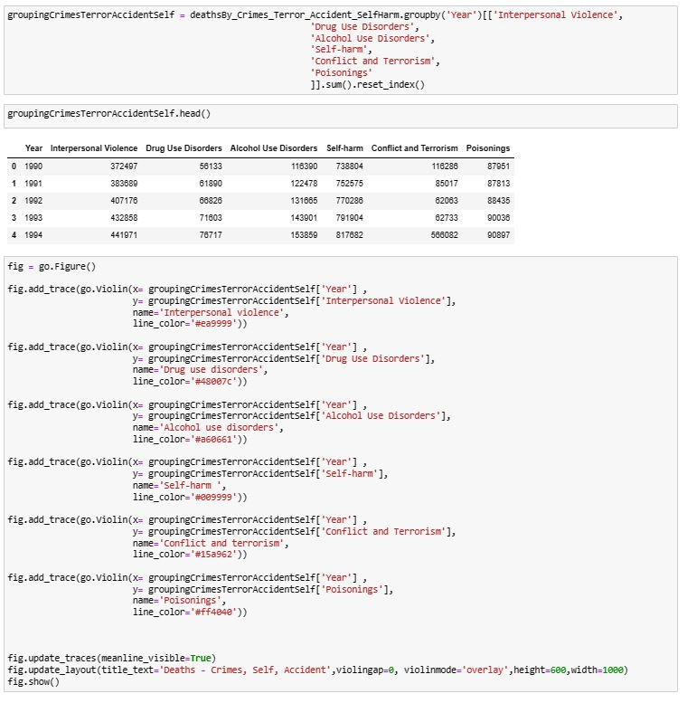
Death by crime, terror , self harm

Slide 16
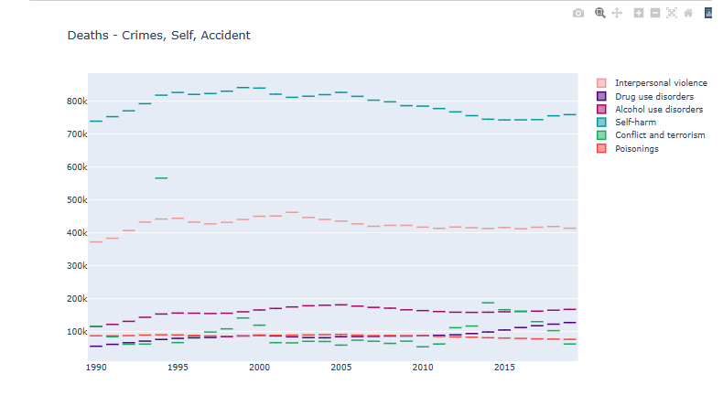
We can clearly see in this plot come to know that in all the years the maximum death have been taken place by Conflicts and Terrorism and the max death was in between 1990 and 2000.Poisoning seems to be constant in all the years.
The second highest death has taken place by Interpersonal violence
And rest all the case of seems to be under 200k in all the given years.

Slide 17
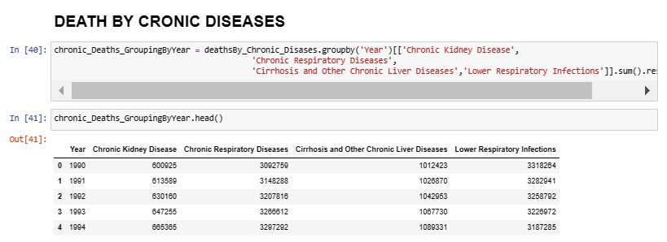
Death by chronic diseases

Slide 18
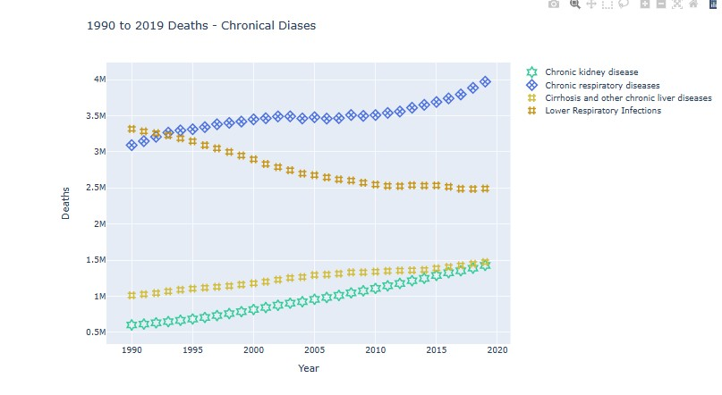
WE CAN SEE THAT THE MAXIMUM DEATH IS CAUSED BY CHRONIC RESPIRATORY DISEASES AND LEAST DEATH IS CAUSED BY CHRONIC KIDNEY DISEASES IN ALL THE GIVEN YEARS WHICH IS 1990 TO 2019.

Slide 19
conclusion
Total rows 6120 and 34 columns in the dataset.
I found out that there are many diseases which continuously increasing such as Neoplasms, HIV/AIDS, Diabetes, Cardiovascular Diseases, Digestive disorder and Alzheimer
Found out that there are many diseases which are continuously decreasing too such as Acute Hepatitis, Diarrheal Diseases, Nutritional Diseases and Meningitis
Parkinson Diseases seems to be constants till 1990 to 1993 after that no data is present for the same.
We can see that in all the given years i.e. 1990 to 2019, Road accident have taken Maximum life’s and the least can death can be seen in Exposure to force of Nature
In case of Death by crime, self-harm and Accident -> Maximum death have been taken place by Conflict and Terrorism and the second highest death have been recorded by -Interpersonal Violence.
Rest all other factors of death are under 200k which can be even further minimized
ALL THE GOVERNMENT AND CONCERNED BODIES SHOULD TAKE RESONABLE STEP TO ENSURE THAT ALL THE AREAS WITH MAXIMUM DEATHS CAN BE MINIMIZED AND PROPER ACTION SHOULD BE TAKEN
IN CASE OF CONFLICT &TERRIOSM AND INTERPERSONAL VIOLENCE SO THAT IT SHOULD BE REDUCED TO MINIMAL.

Slide 20
THANK YOU

